Slide 1
Health and housing partnerships
[Name] [Job title / organisation]

Slide 2
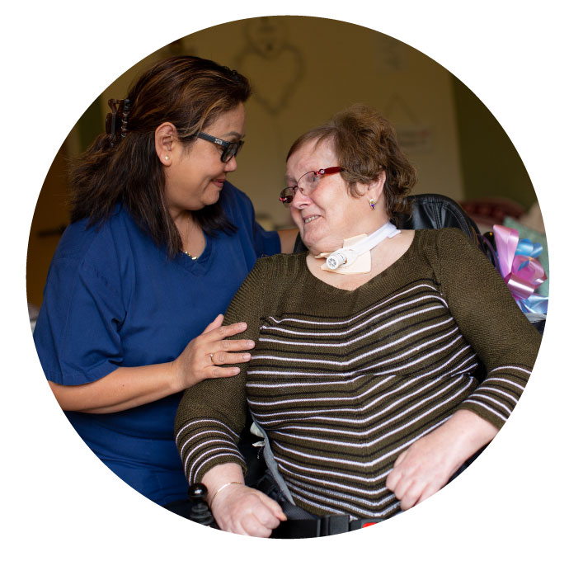
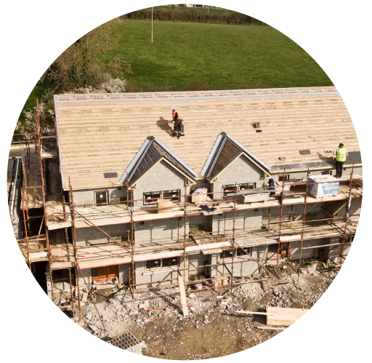
Health and housing partnerships
Today
the impact of good housing on health outcomes
reflections on how we might continue to strengthen these partnerships

Slide 3
The impact of housing on health:
Home and services
Promoting good health through high quality, warm housing:
39% fewer hospital admissions for cardiorespiratory conditions and injuries in those with homes upgraded under WHQS
3.9% reduction in GP visits for respiratory conditions for those with home energy improvements (vs 9.8% increase in control group)
Poor housing costs the NHS in Wales £95m/year in treatment costs
Full cost to society of leaving people living in poor housing in Wales is estimated to be around £1bn/year

Slide 4
The impact of housing on health:
Home and services
Preventing hospital admission through accessible and adapted housing:
Between 2017 and 2035, the no. of people aged 65+ admitted to hospital because of a fall is estimated to increase by 63%; those unable to manage at least one domestic task on their own will increase by 46%
People in homes that lack necessary adaptations are between 1.5 and 2.8 times more likely to suffer a fall than those where interventions are in place
For every £1 spent on adaptations, prior to hospital discharge, there is a saving of £7.50 for health and social care

Slide 5
The impact of housing on health:
Home and services
Promoting independence through housing with care and support:
90% of Extra Care schemes in Wales are managed by housing associations
Sheltered housing residents consistently strive to maintain their health and well‐being through individual and collective action
For each person living in housing with care settings, there is an annual financial benefit to the NHS of approx. £2k
Sheltered housing in England provides an estimated total cost saving of £486m per year in social value

Slide 6
The impact of housing on health:
Home and services
Reducing health inequalities through affordable, secure housing:
Research found that entering unaffordable housing is detrimental to the mental health of those in low-to-moderate income households
There is a clear association between moving home more frequently and poor health
Preventing homelessness can result in savings of c.£9,266 per person, vs allowing homelessness to persist for 12 months
We are paying for crisis care vs prevention. Of the 50%+ of Welsh Govt budget allocated to health, 74% is directed to acute services

Slide 7
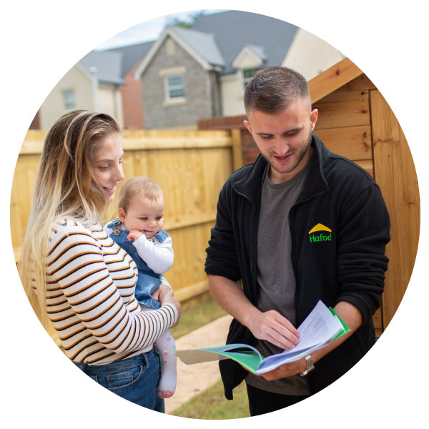
The impact of housing on health:
Sharing our resources
Housing associations are rooted in place and communities
Health inequality is not random. Reducing poverty matters and makes a real difference
By sharing our unique resources, assets and local insight we can amplify the efforts of our partners
We can support health and social care partners to increase their reach to communities and improve outcomes for individuals

Slide 8
Health and housing partnerships
Example: increasing vaccine take up in Butetown, Cardiff, June 2021
Ethnically diverse area, high levels of deprivation
Concern about lower take-up of vaccine amongst residents
Partnership with Muslim Doctors Cymru and local community leaders to deliver a local drop-in vaccine session
3 local HA supported through appropriate local space, staff, communication channels with residents, supporting logistics i.e.: booking system

Slide 9
Health and housing partnerships
Example: empowering individuals to make healthier life choices in Pontypridd
Health and wellbeing project ‘Hapi’ (Happy, Aspiring, Prosperous and Inclusive)
Free 1-2-1 advice and group workshops in emotional wellbeing; physical activity; food and nutrition; education, employment and training
Running in Rhondda Cynon Taf since 2016
In 2021, received funding from Cardiff & Vale UHB to extend project to communities in Cardiff and the Vale of Glamorgan

Slide 10
Health and housing partnerships
Example: supporting citizens’ positive mental health and emotional well-being in Rhyl
Coastal town where healthy life expectancy can vary by up to 12 years compared with other areas of the country
‘I CAN’ community hub, a partnership between ClwydAlyn housing association and Betsi Cadwaladr UHB
Individuals can access a range of services within a non-stigmatised community setting
Since reopening following lockdown restrictions, support provided to 96 individuals (referrals from GPs, probation service, police, hospitals, CAB, voluntary organisations)

